Slide 1
CAO LAB #2 Introduction To VVM Programming
ENGR.RAMSHA MASHOOD

Slide 2
VVM PROGRAMMING LANGUAGE
VVM has its own simple Programming Language which supports such operations as conditional and unconditional branching, addition and subtraction, and input and output, among others.
VVM programs can be written in Machine Language, in Assembly Language, or in a combination of both
In the Machine Language format, each instruction is a three-digit integer where the first digit specifies the operation code (op code), and the remaining two digits represent the operand.
In the Assembly Language format, the operation code is replaced by a threecharacter mnemonic code

Slide 3
Language Instructions
The eleven operations of the VVM Language are described below. The Machine Language codes are shown in parentheses, while the Assembly Language version is in square brackets.
Load Accumulator (5nn) [LDA nn]
Store Accumulator (3nn) [STO nn] (or [STA nn])
Add (1nn) [ADD nn]
Subtract (2nn) [SUB nn]
Input (901) [IN] (or [INP])
Output (902) [OUT] (or [PRN])
Halt (0nn) [HLT] (or [COB])

Slide 4
Branch if Zero (7nn) [BRZ nn]
This is a conditional branch instruction. If the value in the Accumulator Register is zero, then the Program Counter Register is replaced by the operand value nn. The result is that the next instruction to be executed will be taken from address nn rather than from the next sequential address. Otherwise (Accumulator <> 0), the Program Counter Register is incremented by one, and the next sequential instruction is executed.

Slide 5
Branch if Positive or Zero (8nn) [BRP nn]
This is a conditional branch instruction. If the value in the Accumulator Register is positive or zero, then the Program Counter Register is replaced by the operand value nn. The result is that the next instruction to be executed will be taken from address nn rather than from the next sequential address. Otherwise (Accumulator < 0), the Program Counter Register is incremented by one, and the next sequential instruction is executed.

Slide 6
Branch (6nn) [BR nn] (or [BRU nn] or [JMP nn])
This is an unconditional branch instruction. The current value of the Program Counter Register is replaced by the operand value nn. The result is that the next instruction to be executed will be taken from address nn rather than from the next sequential address. The value of the Program Counter Register is not incremented with this instruction.

Slide 7
NOP & DAT INSTRUCTION
No Operation (4nn) [NOP] (or [NUL])
This instruction does nothing other than increment the Program Counter Register by one. The operand value nn is ignored in this instruction and can be omitted in the Assembly Language format.
Embedding Data in Programs
Data values used by a program can be loaded into memory along with the program. In Machine or Assembly Language form simply use the format “snnn” where s is an optional sign, and nnn is the three-digit data value. In Assembly Language, you can specify “DAT snnn” for clarity.

Slide 8
The VVM Load Directive
By default, VVM programs are loaded into sequential memory addresses starting with address 00.
The syntax of the Load Directive is “*nn” where nn represents an address in memory.
When this directive is encountered in a program, subsequent program elements are loaded in sequential addresses beginning with address nn.

Slide 9
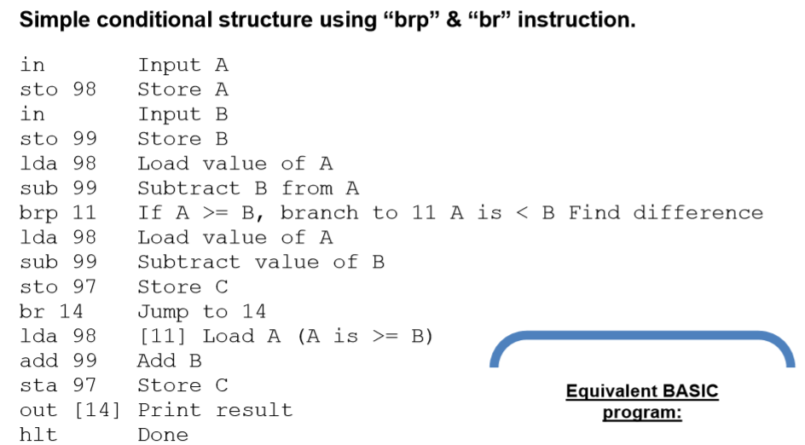
BRP AND BR EXAMPLE

Slide 10
LAB TASKS
1. Take any integer as input, if the number is greater than 5 print it
If a>5, print a
Else if a=0,then Halt
Else if a<5,then halt
2. Take two numbers as input and print the larger number.

